Slide 1
Decision Trees
Geoff Hulten

Slide 2
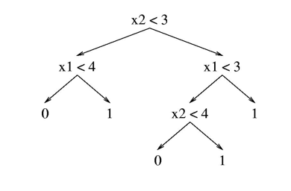
Overview of Decision Trees
A tree structured model for classification, regression and probability estimation.
  CART (Classification and Regression Trees)
Can be effective when:
  The problem has interactions between variables
  There aren’t too many relevant features (less than thousands)
  You want to interpret the model to learn about your problem
Despite this, simple decision trees are seldom used in practice.
Most real applications use ensembles of trees (which we will talk about later in the course).

Slide 3
Reminder: Components of Learning Algorithm
Model Structure
Loss Function
Optimization Method

Slide 4
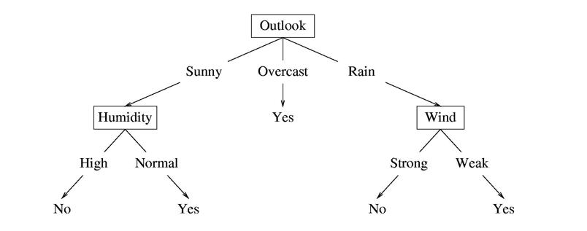
Structure of a Decision Tree
Internal nodes test feature values
One child per possible outcome
Leaves contain predictions
Humidity | Outlook | Wind | Prediction
Normal | Rain | Strong
Normal | Sunny | Normal
No
Yes

Slide 5





Decision Trees: Basic Tests
$$x_{i}=0?$$
Binary Feature
Categorical Feature
Numeric Feature
False
True
$$x_{i}?$$
$${Value}_{1}$$
$${Value}_{n}$$
…
$$x_{i}<101.2?$$
False
True

Slide 6



Decision Trees: Leaf Types
Classification
Regression
Probability Estimate
$$y=1$$
$$y=101.2$$
$$p\left(y=0\right)= .3$$
$$p\left(y=1\right)= .3$$
$$p\left(y=2\right)= .4$$

Slide 7
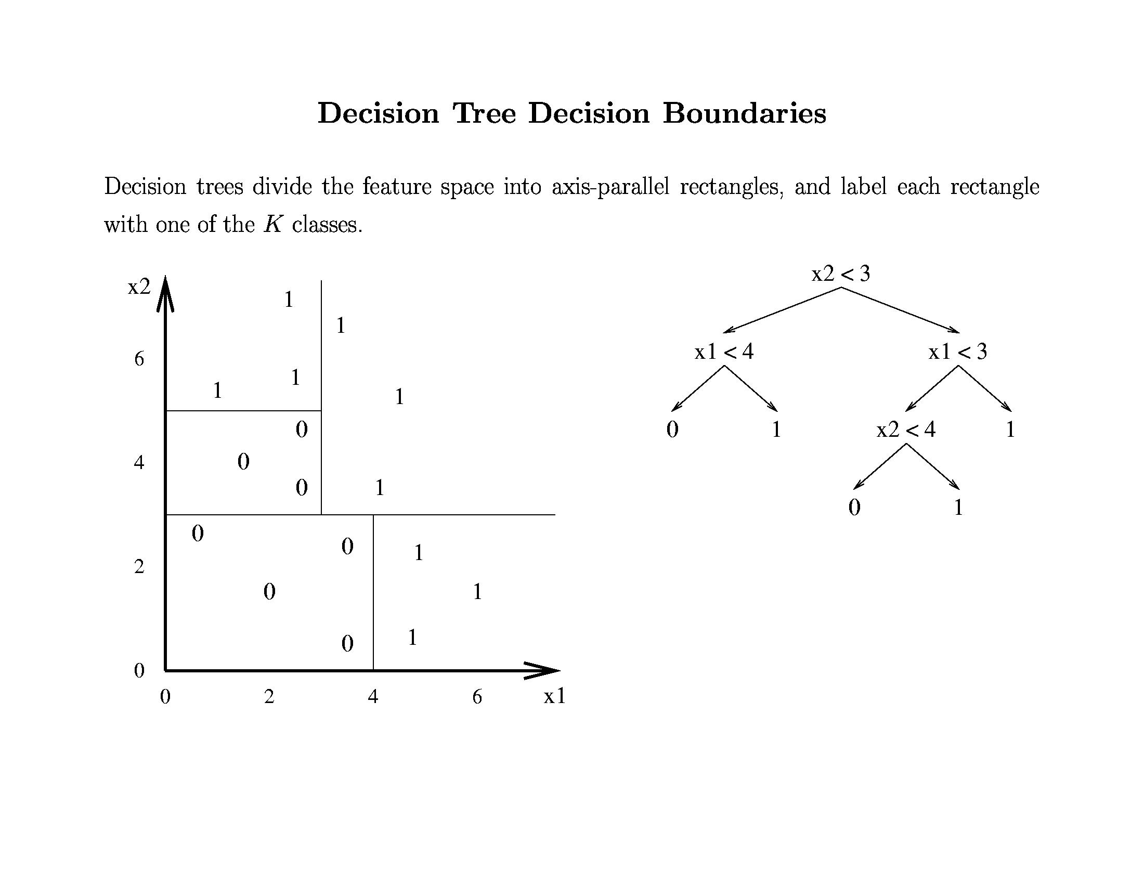

Slide 8
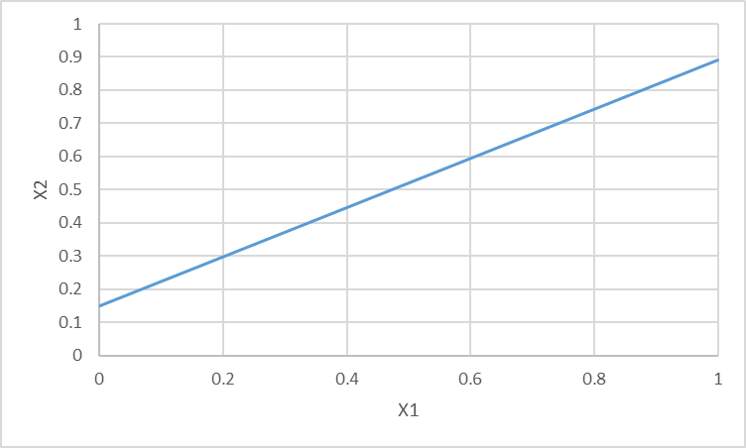
Decision Trees vs Linear Models
1
0
Adding nodes (structure) allows more powerful representation

Slide 9
Summary of Decision Tree Structure
Supports many types of features and predictions
Can represent many functions (may require a lot of nodes)
Complexity of model can scale with data/concept

Slide 10

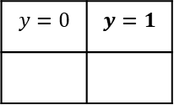

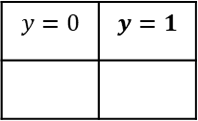


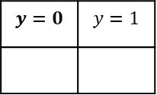
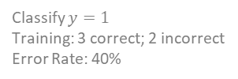

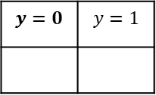

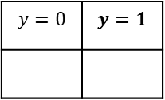
Loss for Decision Trees with Classification
Tree overall error rate: 40%
Classify $y=1$
Training: 3 correct; 2 incorrect
Error Rate: 40%
$$x_{1}=1?$$
False
True
Given tree structure:
- Given a tree with parameters
- Pass data through tree to find leaf
- Estimate the loss on the leaf
- Sum across data set
Tree Loss: sample weighted sum of leaf loss
Loss reduction (aka Information Gain):
- Tree with less loss > tree with more loss
- Loss reduction key step in optimization
Making a leaf more complex:
- Affects loss of all samples at that leaf
- Does not affect loss of other samples
$$x_{1}$$
0
1
0
1
0
1
0
1
0
1
$$x_{2}$$
1
1
1
1
1
0
1
0
1
0
$$y$$
1
1
1
1
1
0
0
0
0
0
$$y=0$$ | $$y=1$$
$$y=0$$ | $$y=1$$
2
3
3
2
Tree overall error rate: 20%
$$x_{1}=1?$$
False
True
$$y=0$$ | $$y=1$$
$$x_{2}=1?$$
2
3
False
True
$$y=0$$ | $$y=1$$
$$y=0$$ | $$y=1$$
3
0
0
2
Leaf error rate: 0%
Leaf error rate: 0%

Slide 11
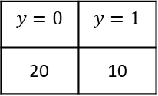
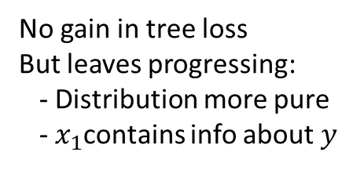
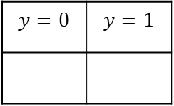
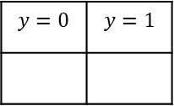

Loss: Consider Training Set Error Rate
$$Loss\left(y^{^},y\right)= \frac{1}{n}\sum_{i=1}^{n}{0 if\left(y^{^}=y\right)else 1}$$
No gain in tree loss
But leaves progressing:
- Distribution more pure
- $x_{1}$contains info about $y$
Tree error rate: ~33%
Tree error rate: ~33%
$$x_{1}=1?$$
False
True
Tree with 0 Splits
$$y=0$$ | $$y=1$$
20 | 10
$$y=0$$ | $$y=1$$
$$y=0$$ | $$y=1$$
12
8
8
2
Leaf error rate: ~33%
Leaf error rate: 40%
Leaf error rate: 20%

Slide 12
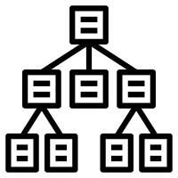

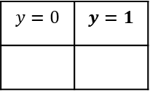
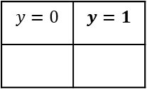









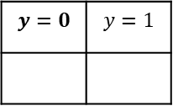

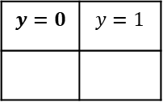
Entropy of a Distribution – Information Theory
The number of bits of information needed to complete a partial message
$${<x}_{1},x_{2}>$$
$$y^$$
$$y$$
Extra Information
$$x_{1}=1?$$
False
True
$$y^$$
$$x_{1}$$
$$y=0$$ | $$y=1$$
$$y=0$$ | $$y=1$$
$$y$$
0
10
10
0
None Needed
$$x_{1}=1?$$
False
True
$$y^$$
$$x_{1}$$
$$y=0$$ | $$y=1$$
$$y=0$$ | $$y=1$$
$$y$$
5
5
5
5
1 bit needed

Slide 13
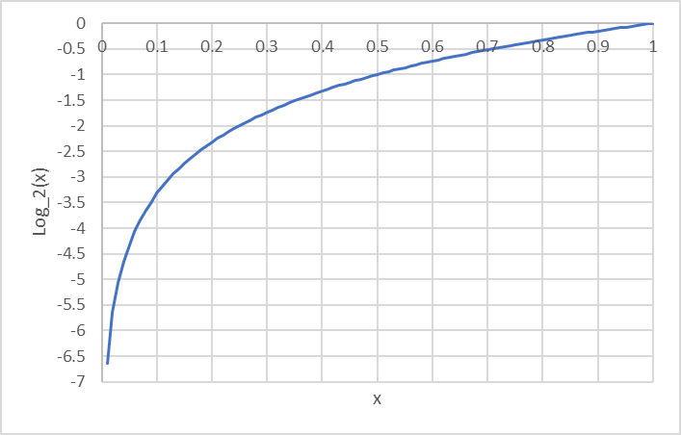

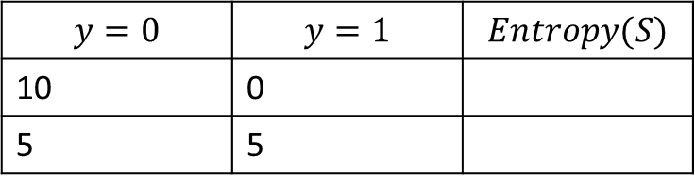




Entropy of a distribution
$$Entropy\left(S\right)=−\sum_{i∈\{y\}}{p\left(y=i\right)∗\log_{2}(p\left(y=i\right))}$$
$$P\left(y=0\right)∗\log_{2}\left(p\left(y=0\right)\right)+p\left(y=1\right)∗\log_{2}{(p\left(y=1\right))}$$
$$y=0$$ | $$y=1$$ | $$Entropy(S)$$
10 | 0
5 | 5
$$=$$
$$.5∗−1+ .5∗−1$$
$$=$$
$$1$$

Slide 14
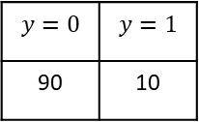

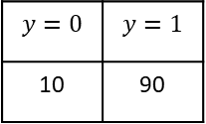


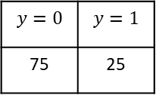
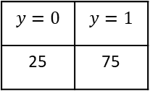
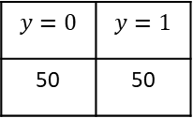
Loss for Decision Trees
$$Loss\left(S\right)= \frac{1}{n}\sum_{i=1}^{n}{Entropy(Leaf\left(S_{i}\right))}$$
$$y=0$$ | $$y=1$$
50 | 50
Entropy: 1
Information Gain ~.2
$$x_{1}=1?$$
False
True
Entropy: ~.8
$$y=0$$ | $$y=1$$
25 | 75
$$y=0$$ | $$y=1$$
75 | 25
Information Gain ~.33
Entropy: ~.47
$$x_{2}=1?$$
False
True
Information Gain – reduction in Entropy (loss) from a change to the model
$$y=0$$ | $$y=1$$
10 | 90
$$y=0$$ | $$y=1$$
90 | 10

Slide 15
Decision Tree Optimization
Greedy Search
Single Step of lookahead
Algorithm Outline:
  Start with single leaf
  Calculate Information Gain of adding a split on each feature
  Add the split with the largest gain
  Sort data into the leaves of the new tree
  Continue recursively until some stopping criteria

Slide 16
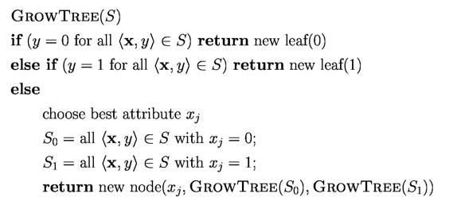
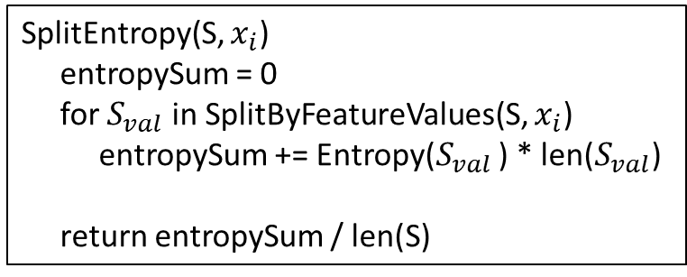
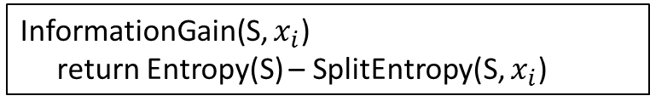
Decision Tree Optimization
SplitEntropy(S, $x_{i}$)
entropySum = 0
for $S_{val}$ in SplitByFeatureValues(S, $x_{i}$)
entropySum += Entropy($S_{val}$ ) * len($S_{val}$)
return entropySum / len(S)
Partition data set by selected feature
Termination condition
InformationGain(S, $x_{i}$)
return Entropy(S) – SplitEntropy(S, $x_{i}$)
One step lookahead
BestSplitAtribute(S)
informationGains = {}
for i in range(# features):
informationGains[i] = InformationGain(S, i)
if AllEqualZero(informationGains):
# Additional Termination Case…
return FindIndexWithHighestValue(informationGains)
Recursive calls on partitioned data sets

Slide 17
Stopping Criteria?
When no further split improves Loss
  Run out of features
  Min information gain to split
  Leaf is pure
When there isn’t enough data to make good decisions
  Min number of samples to grow
When the model is complex enough
  Number of nodes in the tree
  Maximum depth of the tree
  Loss penalty for complexity
Hybrid
  Very common…
  Decision trees tend to overfit
Pruning

Slide 18
Splitting Non-binary Features
Categorical Features
  One child per possible value
  One vs the rest
  Set vs the rest
Numerical Features
  Split at each observed value
  Split observed range evenly
  Split samples evenly

Slide 19
Predicting with Decision Trees
Take the new sample, pass it through the tree until it reaches a leaf:
Binary classification
  Return most common label among training samples at the leaf
Categorical classification
  Return most common label among training samples at the leaf
Probability estimate
  Return (smoothed) probability distribution defined by samples at leaf
Regression
  Return the most common value at leaf
  Linear regression among samples at leaf

Slide 20
Interpreting Decision Trees
Understanding Features
  Near the root
  Used many times
  Big loss improvements in aggregate
Prominent paths
  Taken by many samples
  Highly accurate
  Taken by important (expensive) samples

Slide 21
Decision Tree Algorithm Summary
Recursively grow a tree
  Partition data by best feature
  Reduce entropy
Flexible and simple
  Feature types
  Prediction types
Hyper Parameters
  How to partition by features (numeric)
  How to control complexity
Base to important algorithms
  AdaBoost (stumps)
  Random forests
  GBM (Gradient Boosting Machines)

